Slide 1
Student Information System Using Cloud Computing
Team Members
1.AISWARYA.M
2. ANJANA MANOJ
3.DEEPTHI.K.T
Facultyguide : Industrial guide :
KAMALA.V GOKUL
Assistant professor Designation
Department of CSE
Department of CSE, KGiSL Institute of Technology, Coimbatore

Slide 2
Abstract
Cloud computing has emerged as a new compelling paradigm for the deployment of Applications and services .It represents an evolution of cloud programming models, abstractions, platforms and is a testament to the maturity and wide adoption of Cloud technologies.
Create web application that enables users to request rides without servers. The application will present users with an HTML based user interface for indicating the location where they would like to be picked up and will interface on the backend with a RESTful web service to submit the request and dispatch a nearby unicorn. A Static Website to be hosted with User Management and a cloud based backend is created. JavaScript executed in the browser sends and receives data from a public backend API built using Lambda and API Gateway.
Department of CSE, KGiSL Institute of Technology, Coimbatore

Slide 3
Area Introduction-Existing system
In the existing computing system server based computing is used.
Server-based computing (SBC) is an over-arching term referring to the technology by which applications are implemented, controlled, supported and functioned on the server . Upgrading hardware, application deployment, backing up of data and technical support are simplified in a server-based environment. We need the sever room to handle the systems and to store the data.
Department of CSE, KGiSL Institute of Technology, Coimbatore

Slide 4
Proposed System
Advantages over existing methods
The biggest advantage of cloud computing is that there is nomore provisioning or managing of physical servers. It is not that servers are troublesome.
There is no need for the physical setup so that the implementation cost will be very less.
Data will be stored in very secured way.
Disaster recovery is the other very important benefit of cloud computing .
Future Enhancements
More security can be ensured by providing security devices.
Encryption technologies can be used.
Department of CSE, KGiSL Institute of Technology, Coimbatore

Slide 5
Literature Review
Drawbacks of existing methods
The existing system needs the physical servers so that the cost for implementing this will be very high.
It will consumes more space for the physical setup including all other networking devices.
The data will not be secured and data can’t be recover after any disaster.
References: www.nevon.com
Department of CSE, KGiSL Institute of Technology, Coimbatore

Slide 6
ARCHITECTURAL DIAGRAM
Student
Management
Cloud Admin
Student
Application layer
View Events
Register Events
Publish Events
Middle layer
Cloud Storage
Data base layer

Slide 7
DFD
User
Login
Sign up
Main page
About us
Publish events
Event type

Slide 8
Cntd..
Publish data store
Event data store
publish
Hackathons
Seminars
Symposium
Workshops
cloud data store

Slide 9
Module Split-up
Module 1:
Static Web Hosting
Module 2:
User Management
Module 3:
Serverless Backend
Module 4:
RESTful API’s
Module 5:
Resource Termination And Next Step
Department of CSE, KGiSL Institute of Technology, Coimbatore

Slide 10
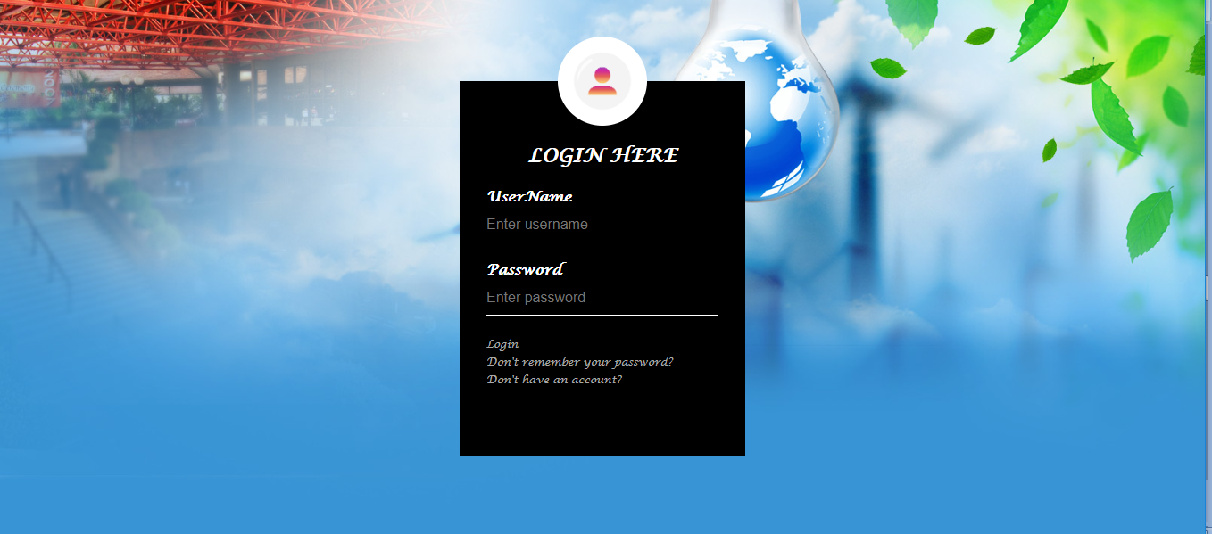
Screen shots of modules under progress.
Department of CSE, KGiSL Institute of Technology, Coimbatore

Slide 11
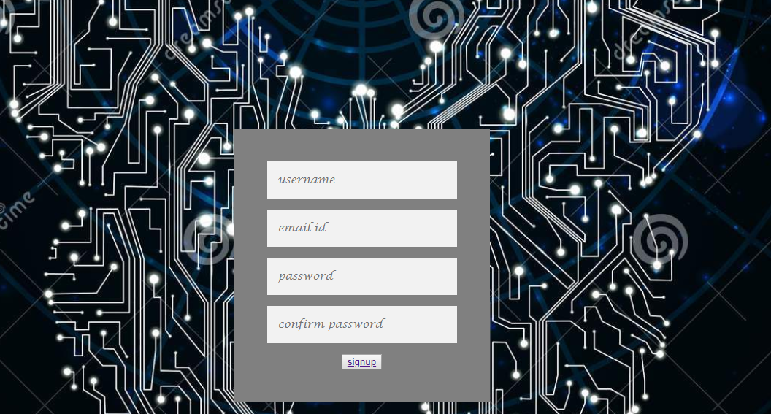
Cntd..

Slide 12

Ctnd…..

Slide 13
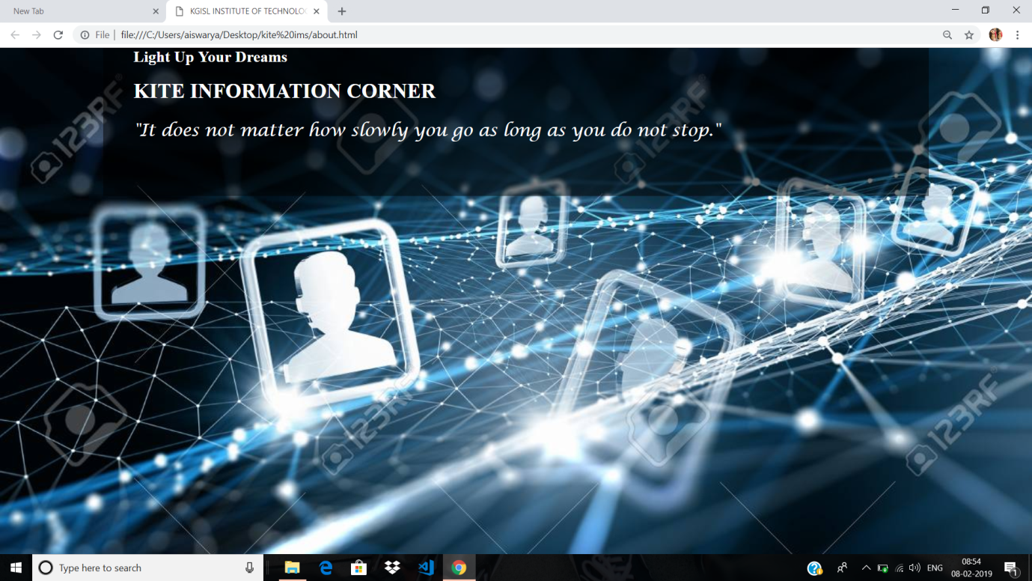
Cntd…

Slide 14
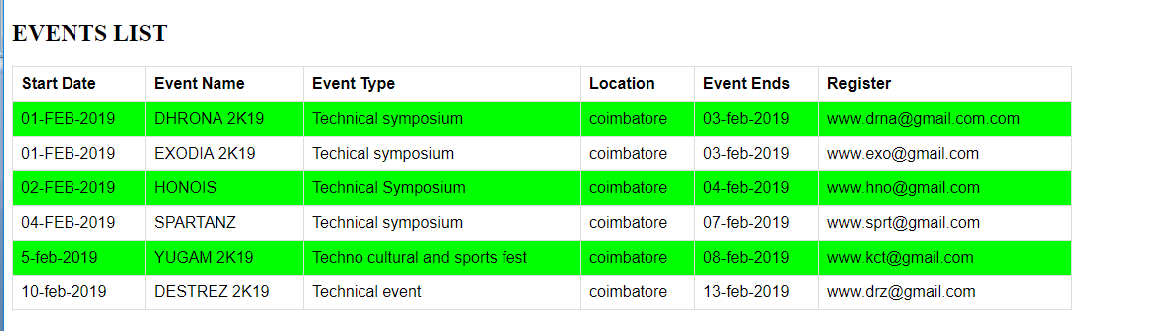
Ctnd…..

Slide 15

Ctnd..

Slide 16
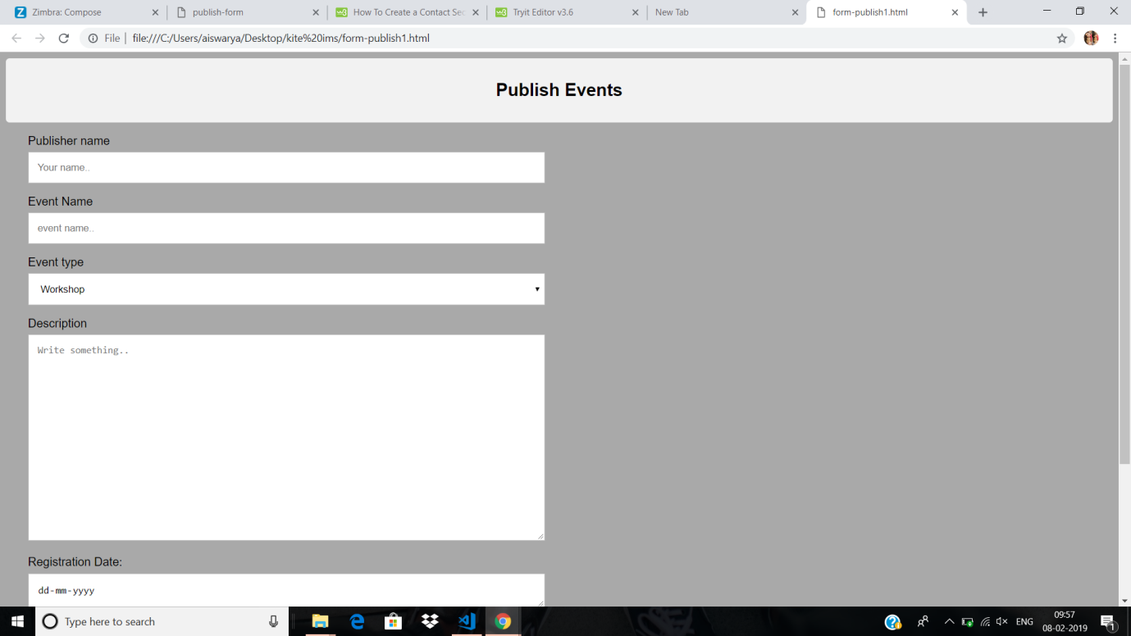
Cntd..

Slide 17
Thank You
Department of CSE, KGiSL Institute of Technology, Coimbatore

